Slide 1
Navigating BookItLab (click below to skip to slide) Registering as a New User Creating a New Project Adding a Comment or Attachment to Project Cancelling a Project

Slide 2
Registering as a New User

Slide 3
Click on New User
Back to Title Page

Slide 4
Fill out details accordingly
Back to Title Page

Slide 5
Once complete, fill in captcha, and click “Sign Up”
Step 1.
Step 2.
Back to Title Page

Slide 6
Creating a New Project
Microbiome-Amplicon NGS Projects
Next Generation Sequencing Projects
Nucleic Acid Isolation Projects
Real-Time PCR Projects
For any other projects not listed, please contact GMCF staff directly via email.

Slide 7
Go to “Sample Requests” under “Request Services”

Slide 8
Click on “+Service Request”

Slide 9
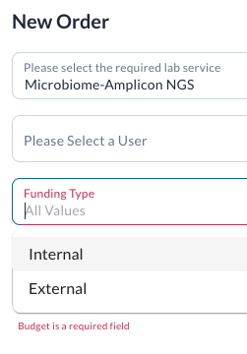
Choose desired lab service and appropriate Funding Type *For internal customers, budget numbers will automatically populate, please select the correct one before confirming*

Slide 10
Once filled, select the clickable “Confirm” button

Slide 11
Microbiome-Amplicon NGS Projects
Fill out project details AND/OR upload/attach the sample submission form below in comment section.

Slide 12
Next Generation Sequencing Projects (shotgun/WGS/ssDNAseq/RNAseq)
Fill out project details AND/OR upload/attach the sample submission form below in comment section.

Slide 13
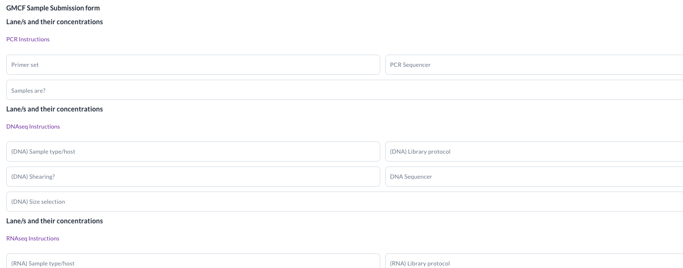
Nucleic Acid Isolation Project
Fill out sample details (and downstream sequencing details if necessary) AND/OR upload/attach the sample submission form below in comment section.

Slide 14
Real Time PCR Projects
Fill out project details AND/OR upload/attach the sample submission form below in comment section.

Slide 15
Adding a Comment or Attachment to Project
ALWAYS upload electronic sample submission forms to BookItLab (or email GMCF staff) & include hard copy in sample shipment
Use comments to contact us about any project inquiries, status updates, or questions.

Slide 16
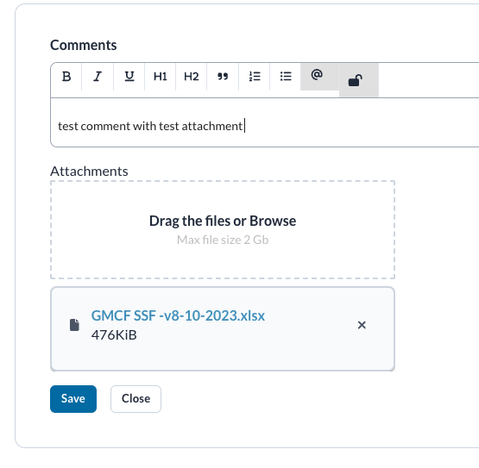
Add comment an/or attachments, click “Save” To address and notify any GMCF staff, please @ them in the comments (*see next slide for list of staff users) *NOTE: you MUST add a comment in order to upload attachment*

Slide 17
GMCF/RRBC Staff | BookItLab User | Email
Stefan Green (Director of Core Services) | @stefang | stefan_green@rush.edu
Kevin Kunstman (Director of GMCF) | @kevink | kevin_kunstman@rush.edu
Ankur Naqib (Director of RRBC) | @ankur | ankur_naqib@rush.edu
Ping Li (Manager, GMCF) | @ping | ping_li@rush.edu
Félix Araujo-Perez (NGS projects) | @perezaf | felix_araujoperez@rush.edu
Edith Perez (RNAseq, Nucleic Acid Isolation projects) | @pereze | edith_perez@rush.edu
Cecilia Chau (ddPCR, qPCR, Amplicon projects) | @chau | cecilia_s_chau@rush.edu
Gian Balangue (NGS, Nucleic Acid Isolation, qPCR, RNAseq projects) | @gianb | giancarlo_s_balangue@rush.edu
Ashley Wu (Amplicon projects) | @ashleyw | lokyiuashley_wu@rush.edu
Trisha Jeon (NGS, Amplicon projects) | @tjeon | trisha_jeon@rush.edu
Marisol Dominguez (NGS projects) | @marisol | marisol_dominguez@rush.edu
Edner Hernandez (Nucleic Acid Isolation projects) | @ehernandez | edner_d_hernandez@rush.edu
Neha Joshi (RRBC) | @neha | neha_joshi2@rush.edu
Surabhi Naik (RRBC) | @surabhi | surabhi_naik@rush.edu
Adit Chaudhary (RRBC) | @adit_chaudhary | adit_chaudhary@rush.edu

Slide 18
Cancelling a Project

Slide 19
Click drop-down options under “Status”, select “Cancel”
Step 1.
Step 2.

Slide 20
Please feel free to let us know if you need help either by BookItLab Comments or by email. Thanks!

